Slide 1

Unit-1 Introduction to Database System
Database Management System-I (DBMS-I)
DU # 2304CS204
CO1: At the end of this unit, students will be able to,
discuss the basic elements of the database.
Prof. Hemang R Chath
Computer Science & Engineering Department
hemang.chath@darshan.ac.in
8200834776

Slide 2

Looping
Outline
Introduction to DBMS
Applications of DBMS
Advantages of DBMS
Basic terms of DBMS
Types of Database Users
DA Vs DBA
Functions and responsibilities of DBA
Three Level ANSI SPARC Database Architecture

Slide 3
Introduction to DBMS

Slide 4
What is Database Management System (DBMS)?
Data – Data can be known facts that can be recorded and stored.
e.g. Person Name, Age, Salary, Result, etc.
Database – Collection of logically related data
e.g. Books Database in Library, Student Database in University etc.
Management – It is a way in which we maintain the data in database.
e.g. Viewing result in University website, Searching exam papers in University website, Updating or Deleting the data in database, etc.
System – Programs or tools used to manage database
e.g. Microsoft Access, SQL Server, Oracle, etc.
Database Management System (DBMS) – A Database Management System is a collection of logically related data and set of programs to manipulate those data in database.
OR
Database Management System (DBMS) is a software designed to define, manipulate, retrieve and manage data in a database.
e.g. MS SQL Server, Oracle, My SQL, SQLite, MongoDB, etc.

Slide 5
Applications of DBMS

Slide 6


















Applications of DBMS
E-commerce
Universities and Colleges/Schools
Social Media
Banking
Government Organizations
Online Television streaming
Airline and railway
E-commerce
Universities, Colleges,
Schools
Airline and railways
Applications
Of
DBMS
Online Television Streaming
Social Media
Exercise
Government
Organization
Write down any five applications of DBMS other than above.
Banking

Slide 7
Advantages of DBMS

Slide 8

Reduce Data Redundancy (Duplication)
Computer
Civil
Emp_Name | Address | Mobile | Subject
Emp_Name | Address | Mobile | Subject
Prof. Ajay Shah | Rajkot | 1234 | PPS
Prof. Ajay Shah | Rajkot | 1234 | PPS
Database management system can remove such data redundancy by storing data centrally.
Same data is stored at
four different places.
Emp_Name | Address | Mobile | Subject
Emp_Name | Address | Mobile | Subject
Prof. Ajay Shah | Rajkot | 1234 | PPS
Prof. Ajay Shah | Rajkot | 1234 | PPS
Electrical
Mechanical

Slide 9
Remove Data Inconsistency
Computer
Civil
Emp_Name | Address | Mobile | Subject
Emp_Name | Address | Mobile | Subject
6789
Prof. Ajay Shah | Rajkot | 1234 | PPS
Prof. Ajay Shah | Rajkot | 1234 | PPS
Same data having
different state (values)
Database management system can keep data in consistent state.
Mobile no is changed
Emp_Name | Address | Mobile | Subject
Emp_Name | Address | Mobile | Subject
6789
Prof. Ajay Shah | Rajkot | 1234 | PPS
Prof. Ajay Shah | Rajkot | 1234 | PPS
Electrical
Mechanical

Slide 10


Guaranteed Atomicity
Atomicity: Either transaction execute 0% or 100%.
Sum of both account before transfer is 3000
Person A
Account A
Bal : 2000
Transfer 500
Person B
Account B
Bal : 1000
Step 1 : Debit 500 from Account A
Step 2 : Credit 500 into Account B
Transaction is failed
Sum of both account is 2500
so inconsistent
Sum of both account
after transfer is 3000

Slide 11
Allow to Implement Integrity Constraints
Emp_Name | Address | Mobile_No | Subject
Prof. Ajay Shah | Rajkot | 9876543210 | PPS
Should contain exact 10 digits
Student_Name | Branch | Backlog | SPI
Nirav Patel | Rajkot | 0 | 8.5
Should be between 0 to 10
DBMS allows us to implement such business rules in our database..

Slide 12

Sharing of Data Among Multiple Users
Want to access
Computer
Civil
Emp_Name | Address | Mobile | Subject
Emp_Name | Address | Mobile | Subject
Prof. Ajay Shah | Rajkot | 1234 | PPS
Prof. Ajay Shah | Rajkot | 1234 | PPS
Database management system allows more than one user to access same data simultaneously.
Want to access
Emp_Name | Address | Mobile | Subject
Emp_Name | Address | Mobile | Subject
Prof. Ajay Shah | Rajkot | 1234 | PPS
Prof. Ajay Shah | Rajkot | 1234 | PPS
Electrical
Mechanical

Slide 13

Restricting Unauthorized Access to Data
File - 1
Emp_Name | Address | Mobile | Subject
Prof. Ajay Shah | Rajkot | 1234 | PPS
Wants to access
Faculty of other college
File - 2
Emp_Name | Post | Salary | Load
Prof. Ajay Shah | Lecturer | 50,000 | 15
Wants to access
Darshan Faculty
File - 3
Emp_Name | Teaching | Knowledge | Rating
Prof. Ajay Shah | Good | Excellent | 9
DBMS prevents unauthorized user to access data.

Slide 14
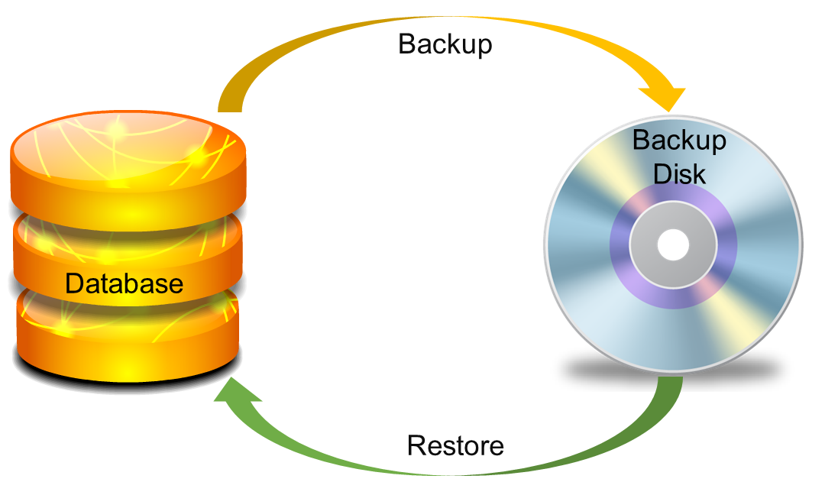
Providing Backup and Recovery Services
Provides facilities to backup and restore the database in case of failure.

Slide 15
Advantages of DBMS (Summary)
Reduce Data Redundancy (Duplication)
Avoids unnecessary duplication of data by storing data centrally.
Remove Data Inconsistency
By eliminating redundancy, data inconsistency can be removed.
Guaranteed Atomicity
Either transaction executes 0% or 100%.
Allow Implementing Integrity Constraints
Business rules can be implemented such as do not allow to store SPI less than 0 and greater then 10.
Sharing of Data Among Multiple Users
More than one users can access same data at the same time.

Slide 16
Advantages of DBMS (Summary)
Restricting Unauthorized Access to Data
A user can only access data which is authorized to him/her.
Providing Backup and Recovery Services
Can take a regular auto or manual backup and use it to restore the database if it corrupts.

Slide 17
Basic Terms of DBMS

Slide 18
Basic terms of DBMS
Data
Data is raw material, unorganized facts that need to be processed.
Example: Marks of students
Student-1 got 50 marks in Maths and 58 marks in Science, Student-2 got 62 marks in C language and 48 marks in Java.
Information
When data is processed, organized, structured or meaningful, it is called information.
Example: Result of students (Pass or Fail) or Percentage of result
Student-1 = Pass, Student-2 = Fail. Or Student-3 pass with 72%

Slide 19
Data v/s Information
Data | Information
Means knows facts, that can be recorded and have implicit meaning. | Means processed or organized data.
Examples: Student No: 112 Student Name: ANKITA Marks : 250 | Examples: Percentage : 81.31% (Derived from the marks of all subjects)
Row materials used to derive information. | Product derived from Data.
Less useful. | More useful.

Slide 20
Basic terms of DBMS (cont…)
Metadata
Metadata is data about data.
Data such as table name, column name, data type, authorized user and user access privileges for any table is called metadata for that table.
Metadata of above table is:
Table name such as Faculty
Column name such as Emp_Name, Address, Mobile_No, Subject
Datatype such as Varchar, Integer, Decimal, etc.
Access privileges such as Read, Write (Update)
Faculty
Emp_Name | Address | Mobile_No | Subject
Prof. Anuj Sharma | Rajkot | 9876543210 | CN

Slide 21
Basic terms of DBMS (cont…)
Data Dictionary
A data dictionary is an information repository which contains metadata.
Data Warehouse
A data warehouse is an information repository which stores data.
Table Name – Faculty
Column Name – EmpName, Address, Mob, Subject, Salary
Datatype – Varchar, Decimal
Access Privileges – Read, Write (Update)
Faculty
Emp_Name | Address | Mobile_No | Subject
Prof. Ajay Shah | Rajkot | 9876543210 | DS
Prof. Raj Patel | Surat | 9023456789 | DBMS

Slide 22
Basic terms of DBMS (cont…)
Field
A field is a character or group of characters that have a specific meaning.
E.g, Emp_Name, Address, Mobile_No, etc are all fields of Faculty table.
Record / Tuple
A record is a collection of logically related fields.
E.g, the collection of fields (Emp_Name, Address, Mobile_No, Subject) forms a record for the Faculty.
Faculty
Emp_Name | Address | Mobile_No | Subject
Prof. Ajay Shah | Rajkot | 9876543210 | PPS
Prof. Ajay Patel | Surat | 0123456789 | DBMS
Fields
Emp_name
Address
Mobile_No
Prof. Ajay Shah | Rajkot | 9876543210 | PPS
Record / Tuple
Prof. Ajay Patel | Surat | 0123456789 | DBMS

Slide 23
Basic terms of DBMS (cont…)
File
A file is a collection of records. For example, if you insert 100 records in Faculty database then these 100 records create a file.
Faculty
Emp_Name | Address | Mobile_No | Subject
Prof. Ajay Shah | Rajkot | 9876543210 | PPS
Prof. Ajay Patel | Surat | 0123456789 | DBMS
Prof. Bimal Rai | Rajkot | 8099766551 | DS
Prof. Ram Zala | Surat | 7888900112 | OOP
……. | ……. | ……. | …….
File

Slide 24
Types of Database Users

Slide 25
Types of Database Users
Naive Users (End Users)
Naive users are unsophisticated users who have little or no knowledge of database systems.
They do not write SQL queries.
They just interact with the database through ready-made application software or database tools.
Examples: Bank clerk, Data entry operator, Railway reservation counter staff
Application Programmers
Application programmers are users who develop application software or programs using languages such as Java, .NET, PHP, Python, etc.
Examples: Software developers, Web developers
Sophisticated Users
Sophisticated users are users who directly interact with the database system without using application programs.
They have good knowledge of DBMS and SQL
Examples: Data Analysts, Engineers, Scientists

Slide 26
Types of Database Users
Specialized Users (DBA – Database Administrator)
Specialized users develop and manage special-purpose database applications and maintain the database system.
They use administration and monitoring tools.
Example: Database Administrator

Slide 27
DA (Data Administrator) and DBA (Database Administrator)

Slide 28
DA (Data Administrator) and DBA (Database Administrator)
DA (Data Administrator)
The data administrator is a person in the organization who controls the data of the database.
DBA (Database Administrator)
The database administrator is a person in the organization who controls the database system and DBMS software.

Slide 29
DA Vs DBA
Basis | DA | DBA
Abbreviation | DA – Data Administrator | DBA – Database Administrator
Role | Person in the organization who controls the data of the database | Person in the organization who controls the database system and DBMS software
Focus | Business focused person | Technically focused person
Responsibilities | Involves more in the requirements gathering, analysis of data | Involved more in the design, development, testing and operational phases
Interaction with DBMS | DBMS Independent | DBMS dependent
User Management | Defines who should access what data | Creates users and grants permissions
Tools Used | Data modeling tools, documentation tools, etc. | DBMS tools like SQL Server Management Studio, Oracle tools, etc.

Slide 30
Functions and Responsibilities of DBA (Database Administrator)

Slide 31
Functions and Responsibilities of DBA
Schema Definition
DBA defines the logical schema of the database.
Storage Structure and Access Method Definition
DBA decides how the data is to be represented in the database & how to access it.
Defining Security and Integrity Constraints
DBA decides on various security and integrity constraints.
Granting of Authorization for Data Access
DBA determines which user needs access to which part of the database.
Assisting Application Programmer
DBA provides assistance to application programmers to develop application programs.
Monitoring Performance
DBA ensures that better performance is maintained by making a change in the physical or logical schema if required.

Slide 32
Functions and Responsibilities of DBA
Backup and Recovery
DBA backing up the database on some storage devices such as DVD, CD or magnetic tape or remote servers and recover the system in case of failures, such as flood or virus attack from this backup.

Slide 33
Three level ANSI SPARC Database Architecture

Slide 34
3 Levels ANSI SPARC Database Architecture
Three Level ANSI - SPARC (American National Standards Institute - Standards Planning and Requirements Committee) database architecture divides a database system into three levels to achieve data abstraction, data independence and security.
External Level (External View)
Conceptual Level (Logical View)
Internal Level (Physical View)

Slide 35




3 Levels ANSI SPARC Database Architecture
EXTERNAL LEVEL (EXTERNAL VIEW)
How data are viewed by each users?
VIEW 1
VIEW 2
VIEW 3
What data are stored and
What relationships exist?
CONCEPTUAL LEVEL
(LOGICAL VIEW)
How the data are actually stored on storage devices?
INTERNAL LEVEL
(PHYSICAL VIEW)
DATABASE

Slide 36
3 Levels ANSI SPARC Database Architecture
Internal level (Physical level)
It describes how a data is stored on the storage device.
Deals with physical storage of data.
Structure of records on disk - files, pages, blocks and indexes and ordering of records
Internal view is described by the internal schema.
Conceptual level (Logical level)
What data are stored and what relationships exist among those data?
It hides low level complexities of physical storage.
For Example, STUDENT database may contain STUDENT and COURSE tables which will be visible to users but users are unaware about their storage.
Database administrator works at this level to determine what data to keep in the database.
External level (View level)
It describes only part of the entire database that an end user concern or how data are viewed by each user.
Different user needs different views of the database, so there can be many views in a view level abstraction of the database. Used by end users and application programmers.
End users need to access only part of the database rather than the entire database.

Slide 37
Advantages of 3 Levels ANSI SPARC Database Architecture
Data independence
Changes to one user's view do not affect other users' views.
Flexibility
Allows changes at any level without affecting other levels.
Hides Complexity
Abstracts low-level details of data storage and organization.
Enhanced Security
Limits data access to each user's view, keeping sensitive data safe.
Storage independence
The internal structure of the database is not affected by changes to the physical storage.
Easy Database Management
Database administrators (DBAs) can change the database structure without affecting users.

Slide 38
Frequently asked questions in Exam
Define the following terms:
Data
Information
Database
DBMS
Metadata
Data Dictionary
Data Warehouse
Field, Record, File
Data VS Information
List out applications of database management system.
List out and explain advantages of database management system.

Slide 39
Frequently asked questions in Exam
List out and explain different types of database users.
Compare DA Vs DBA.
List and explain different tasks/roles/functions/duties of DBA.
Explain three level ANSI SPARC database architecture with suitable diagram.
List out advantages of 3 Levels ANSI SPARC Database Architecture.

Slide 40
Database Management System-I (DBMS-I)
DU # 2304CS204
Prof. Hemang R Chath
Computer Science & Engineering Department
hemang.chath@darshan.ac.in
8200834776

